Slide 1
WEB SERVICES

Slide 2
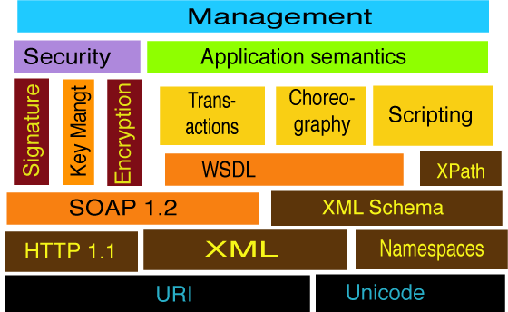
Working Model of Web Services Stack

Slide 3
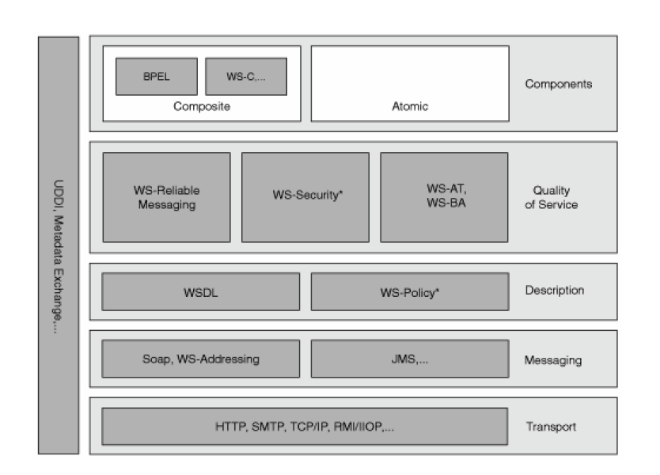
Web Service Stack

Slide 4
WS-A
Enable to identify the message senders and receivers that are associated with message exchange
WS-Addressing decouples address information from the specific transport used
It place the target, source, and other important address information directly within the Web service message.
This specification defines XML elements to identify Web services endpoints and to secure end-to-end endpoint

Slide 5
Contd..
It defines two interoperable constructs as below
Endpoint references and Message information headers.
Endpoint references convey the information needed to identify/reference a Web services endpoint
Message information headers convey end-to-end message characteristics, including addressing for source and destination endpoints and message identity.

Slide 6
Reliable Messaging
WS-Reliable Messaging addresses the issues and defines protocols that enable Web services to ensure reliable, interoperable exchange of messages with specified delivery assurances.
The specification defines three basic assurances:
In-order delivery
At least once delivery
At most once delivery

Slide 7
WS-Coordination
Start new tasks, the execution and disposition of which are coordinated with other tasks
Agree on the outcome of the computation.
WS-Coordination, WS-Atomic Transaction, and WS-Business Activity define protocols that are designed
specifically to address these requirements.
WS-Coordination is a general mechanism for initiating and agreeing on the outcome of multiparty, multimessage Web service tasks.

Slide 8
WS-Coordination Key Elements
WS-Coordination has three key elements
A coordination context
A coordinator service
An interface Participating services
WS-Coordination is a General Framework
WS- AtomicTransaction and WS- BusinessActivity
are two particular protocols that compose with and extend the WS-Coordination

Slide 9
WS-Coordination & Protocols
WS - Atomic Transaction defines a specific set of protocols that plug into WS-Coordination to implement the traditional two-phase atomic ACID transaction
WS - Business Activity defines a specific set of protocols that plug into the WS-Coordination model to provide such long-running, compensation-based transaction protocols

Slide 10
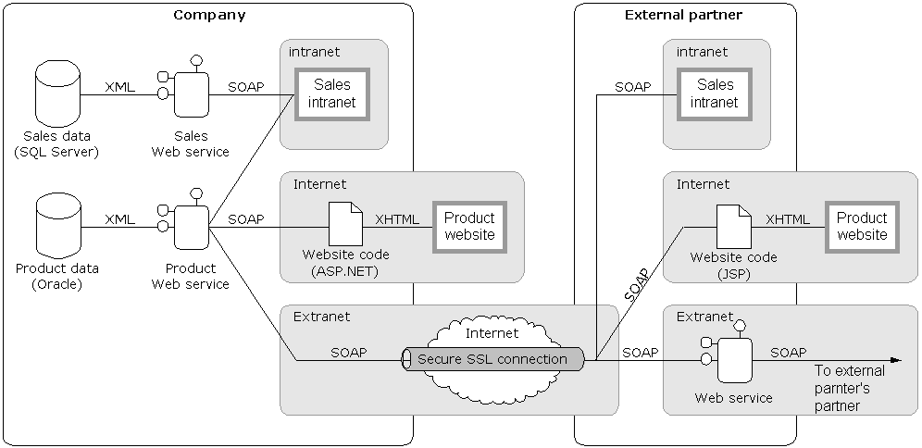
Web services diagram
Note: Simple Object Access Protocol (SOAP) is an XML message format

Slide 11
Reasons to use Web services
Applications can be built that are:
  Platform-independent
  Distributed
  Secure
Web services will become the common architecture for system and application integration
  Based on open industry standards
Companies and government agencies will be able to easily communicate with customers and external partners

Slide 12
More reasons to use Web services
Loosely-coupled and flexible systems are more useful than hard-wired and monolithic ones:
  Example – World Wide Web
  Service Oriented Architecture (SOA)
Companies and government agencies will be able to access software remotely that they or others have already built (reuse)
Organizations will be able to extend the life and value of legacy systems by exposing existing data as XML

Slide 13
Even more reasons to use
Web services
Developers will be able to integrate applications:
  Quickly
  Easily
  Inexpensively
Software development and maintenance time will be reduced
  Increase efficiency 30% – Gartner
Data can be secured using industry standard security methods:
  Secure Socket Layer (SSL) protocol
  Public-key certificates
  WS-Security

Slide 14
Web services technologies
(all based on XML)
Name | Abbreviation | Use
Extensible Markup Language | XML | Language
Universal Description, Discovery, and Integration | UDDI | Discovery
Web Services Description Language | WSDL | Description
Simple Object Access Protocol | SOAP | Request and receive messages

Slide 15
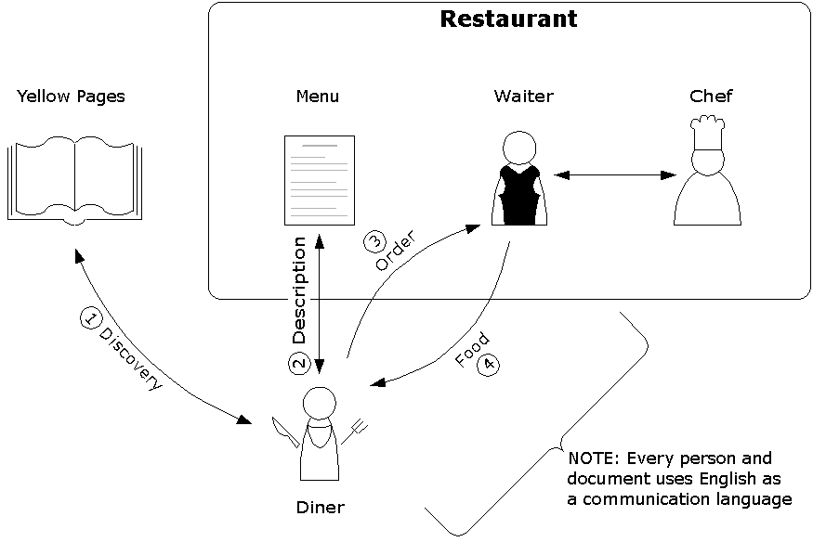
Ordering at a restaurant diagram

Slide 16
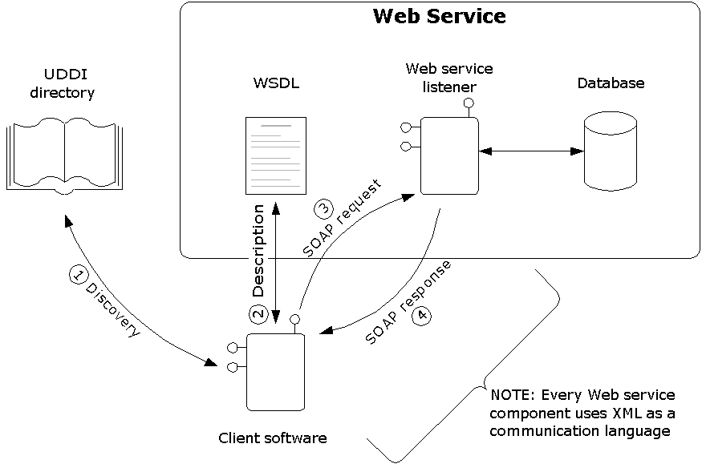
Calling a Web service diagram

Slide 17
Web services issues
Not a silver bullet
  Web services provide plumbing between applications
  However, plumbing is essential
Easy to write, hard to get right
  Distributed and asynchronous software is the hardest to develop and debug
  However, not impossible
XML is wordy
  Takes up a lot of processor time
  and bandwidth
  However, up to a 90% compression ratio

Slide 18
Conclusion
Web services
  Software components that can be run over the Internet using XML
Reasons to use Web services
  Applications can be built that are platform-independent, distributed, and secure
Technologies
  XML, UDDI, WSDL, and SOAP
Web Services Architecture (WSA)
  Set of protocols that solve the problems that every distributed application faces

Slide 19
Links
Web services
http://www.c3daero.com/technologies/webservices.aspx
http://www.pcmag.com/article2/0,4149,103013,00.asp
http://www.pcmag.com/article2/0,4149,519023,00.asp
Web service standards organizations
http://www.w3.org
http://www.ws-i.org
http://www.oasis-open.org
Web service vendors
http://msdn.microsoft.com/webservices
http://www-3.ibm.com/software/solutions/webservices
http://java.sun.com/webservices
http://www.capeclear.com/products/webservices
Companies with Web services
http://www.amazon.com/gp/aws/landing.html
http://www.google.com/apis

Slide 20
MORE INFORMATION….

Slide 21
Universal Description, Discovery, and Integration (UDDI)
“Discovery”
Web service equivalent of the Yellow Pages
Organizations register their Web services in a global directory so clients can find them
The hype:
  Applications will be able to dynamically discover
  new Web services and automatically call them
The reality:
  Provides a layer of software abstraction between
  Web services and client applications
  Example – The URL address of a Web service changes
UDDI is a Web service (uses XML and SOAP)

Slide 22
Universal Description, Discovery, and Integration (UDDI)
Root UDDI directory
  www.uddi.org
Other directories exist:
  uddi.microsoft.com
  uddi.ibm.com
  www.xmethods.net
  www.salcentral.com
Organizations can set up their own
UDDI servers for internal use
  Similar to an office telephone list

Slide 23
Web Service Description Language (WSDL)
“Description”
Web service equivalent of a menu
Uses XML to describe what the Web service can do:
  Interface information (available functions)
  Function data types
  Function location information (URL address)
  Choice of application transfer protocol

Slide 24
Web Service Definition Language(WSDL)
Specification of Web Service Function
  Document Structure
<definitions>
<types>
Complex types for arguments and return types
</types>
<message>
Describe arguments and return values
</message>
<portType> // interface
<operation>
Describe remote procedures
</operation>
</ portType >
<binding>
Protocol used for invoking : SOAP(Application client), HTTP(Web Client), MIME(char & binary data)
</binding>
<service>
<port>
URL of Web Service (endpoint)
</port>
</service>
</definitions>

Slide 25
Application Transfer protocol choices
Hypertext Transfer Protocol (HTTP)
Simple Mail Transfer Protocol (SMTP)
File Transfer Protocol (FTP)
Blocks Extensible Exchange Protocol (BEEP):
  A replacement for HTTP in critical applications
  A generic application layer template
  Uses XML to define the protocol syntax
  Peer-to-peer (can be used client/sever)
  Avoids the use of port 80

Slide 26
Development platforms
Latest development environments and tools understand Web service technologies:
  Microsoft .NET platform
  Java 2 Standard Edition (J2SE) platform
Programmers using .NET and Java do not
need to create or view UDDI, WSDL, or
SOAP files directly
.NET developers only have to mark a function with a [WebMethod] attribute and it can be called across the Internet
Java developers use the @Remote attribute

Slide 27
Distributed application problems
Developers writing distributed applications need a way to provide:
  Security
    Message integrity
    Message confidentiality
    Authentication
    Authorization
    Non-repudiation
  Reliability
  Transactions
  Etc.

Slide 28
Solution: Web Services Architecture (WSA)
Set of infrastructure protocols that solve the problems that every distributed application written with Web services faces
Allows developers to concentrate on writing software
Similar to the U.S. Post Office:
  You can place an addressed, stamped, and sealed envelope in a mailbox and you don’t have to worry about anybody looking inside it or how it will get to
  its destination
  You have the option to use additional services like certified mail

Slide 29
WSA design principles
General purpose
  Independent of application domain
Standards-based
  Uses widely accepted protocols
Federated
  No central point of control, administration,
  or failure
Modular
  Protocols can be used individually or
  work together

Slide 30
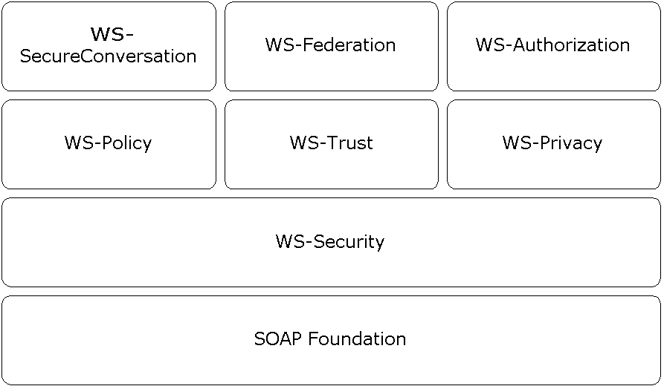
WSA security protocols diagram

Slide 31
WS-Security
The most important WSA security protocol because the other security protocols use it
Provides message integrity:
  XML Signature
    Uses an algorithm to create a message digest
    The recipient compares the digest to the message
    The digest needs to be encrypted
  Security tokens (identity authentication)
    Username and password (needs SSL or VPN)
    X.509 certificate
    Kerberos ticket
Provides message confidentiality:
  XML Encryption
  Security tokens (same as above)

Slide 32
More WSA protocols
WS-ReliableMessaging
  Allows messages to be delivered in the presence of software and network failures
WS-Addressing
  Defines Web service endpoints which
  allow message transmission through
  gateways and firewalls
WS-Routing
  Allows a SOAP message to specify
  a virtualized path through a network

Slide 33
Even more WSA protocols
WS-Attachments
  Allows attached files (documents,
  pictures, sound, video, etc.) to be
  sent with SOAP messages
WS-Transactions
  Allows applications using more than one
  Web service to coordinate changes
Etc.

Slide 34
Web service organizations
Standards organizations:
  World Wide Web Consortium (W3C)
  Web Services Interoperability Organization (WS-I)
  Organization for the Advancement of
  Structured Information Standards (OASIS)
Vendors:
  Microsoft
  IBM
  Sun Microsystems
Companies exposing data as Web services:
  Amazon.com
  Google

